Slide 1
Analysis & Prediction on Wards - In use of Covid 19 Clinical Dataset
Members: Lilin, Swee Ming, Yuh Jiin

Slide 2
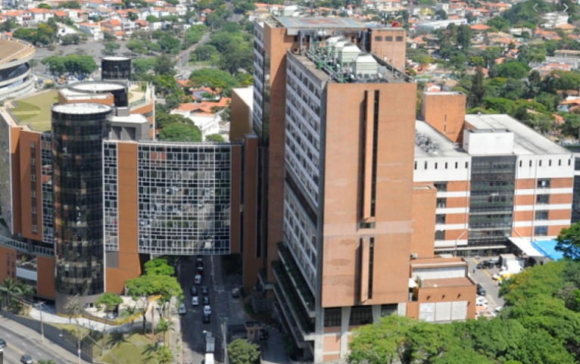
Albert Einstein Isarelite Hospital, Brazil
Large number of cases daily
Delay in diagnostic
test
Sharing data with community to find solutions
https://www.kaggle.com/einsteindata4u/covid19

Slide 3
Healthcare systems have been challenged
Problem Statement
COVID-19 cases have overwhelm the health systems around the world with a demand for ICU beds far above the existing capacity.
The need of hospitalised patients who are infected with COVID-19 are complex.
Based on the severity of illness, patients have been placed to a recommended ward (regular, semi–intensive unit, Intensive care unit)
Due to the scarcity, increasing the ICU units is one way to address it, however, one possible approach is to increase the effectiveness of recommending ICU to only those patients who meets the criteria after their laboratory test results.
Objective
By leveraging on the clinical data and laboratory tests, we seek to predict which patients will need to be admitted to a regular ward, semi-intensive unit, or intensive care unit.

Slide 4
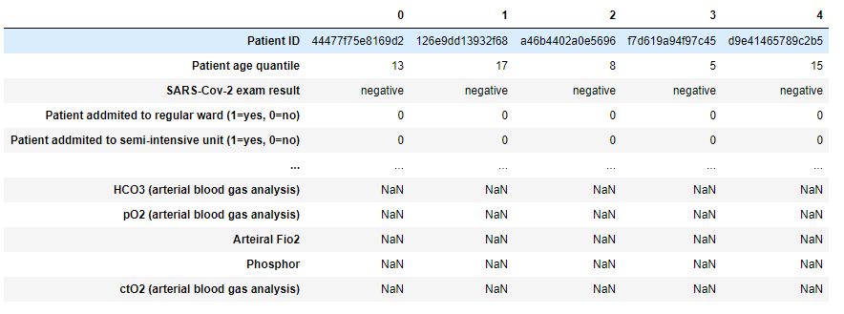
COVID-19 Clinical Dataset
There are a total of 5644 rows and 111 columns (From 28th Mar to 3st Apr 2020)
The dataset contains anonymized data from patients seen at the hospital, and who had samples collected to perform the SARS-CoV-2 RT-PCR and additional laboratory tests during a visit to the hospital.
Notes:
I would suggest using algorithms that can take missing data as input, like randon forest.

Slide 5
Exploratory Data Analysis with Visualization
What are patients allocation size in different wards?
Does all patients with Positive SARS-Cov-2 Exam Results being assigned with a ward?
How many patients are warded?
Which age quantile has the highest number of patients in the ward?
Finding Limitations:
No data provided for the hospital wards capacity,
Only age demographic is available in this data
Notes:
I would suggest using algorithms that can take missing data as input, like randon forest.

Slide 6
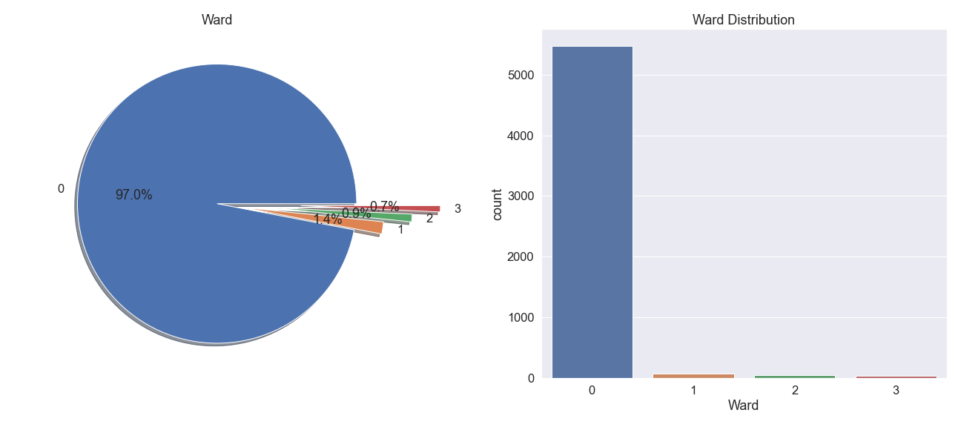
Patients allocation size in different wards
Based on the dataset, there are total 5643 patient recorded, and 97% are not warded, 1.4% are admitted to regular ward, 0.9% are admitted to semi-intensive wards and the remaining 0.7% are admitted to intensive care unit.

Slide 7
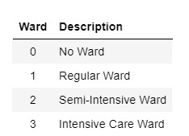
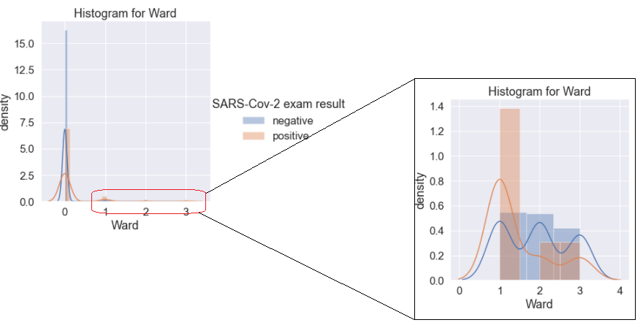
Does all patients with Positive SARS-Cov-2 Exam Results being assigned with a ward?
Most of the patients with positive SARS-Cov-2 exam result, are being placed in the regular ward or not being assigned to a ward.
It suggest that majority of the patients, with positive results, does not have life threatening symptoms.
Notes:
I would suggest using algorithms that can take missing data as input, like randon forest.

Slide 8
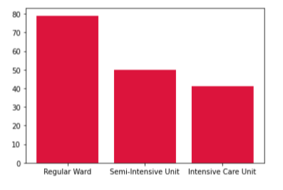
How many patients are warded?
Observation:
Patient admitted to regular ward = 79
*43 are Covid (+), 36 are Covid (-)
Patient admitted to Semi-Intensive Unit = 50
*8 are Covid (+), 42 are Covid (-)
Patient admitted to Intensive Care Unit = 41
*7 are Covid (+), 34 are Covid (-)
Insights:
Not all ICU warded patient are Covid (+), can be due to other diseases and sickness, and not all visitors to hospital will be warded as well due to severity.

Slide 9
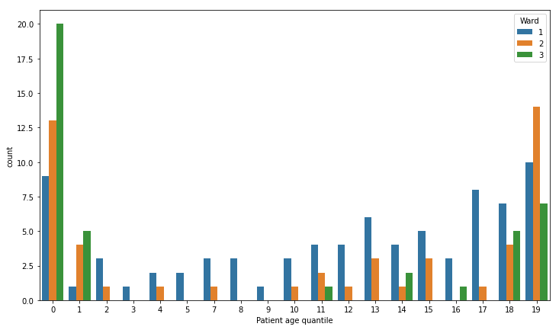
Which age quantile has the highest number of patients in the wards?
What is a Quantile?
In simple terms, a quantile is where a sample is divided into equal sized, adjacent, subgroups. It can also refer to dividing a probability distribution into areas of equal probability
https://www.statisticshowto.com/quantile-definition-find-easy-steps/
Observing from the chart,
0 age quantiles has the highest number of patients admitting to Ward 0 (ICU).
19 age quantiles has the highest number in regular and semi-intensive.
Insights:
There are mostly young ones and elderly patient are warded, probably due to they are more “fragile” and need more medical attention.

Slide 10
Methodology and Workflow
Data Cleaning and Transformation
1st part: Exploratory Data Analysis
2nd Part: Modify the Dataset for next step
Train/Test Split
Lazy Predict, XGB, Extra Tree and Random Forest
Confusion Matrix Classification Report and
Hyper parameter tuning the best model with GridSearch CV
Feature Importance
Missing Values Analysis
Drop Columns
Outliers Observation
Adding Test Indicators
Summarize dataset
Data Visualization
Observe for pattern
Fill missing number
Prepare features to use
Create new columns with the patterns observed
Check dataset distribution
Stratify/Smote imbalanced data
Justify the splitting method
Lazy predict to select
Perform, observe and compare model results
Conduct oversampling and undersampling
Evaluate the performance matrix and pick the best model
Notes:
May use Random Forest to take in the missing values
Cross Validation Analysis to avoid possible overfit due to small dataset

Slide 11
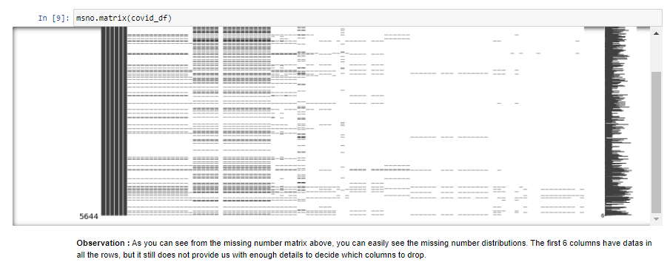
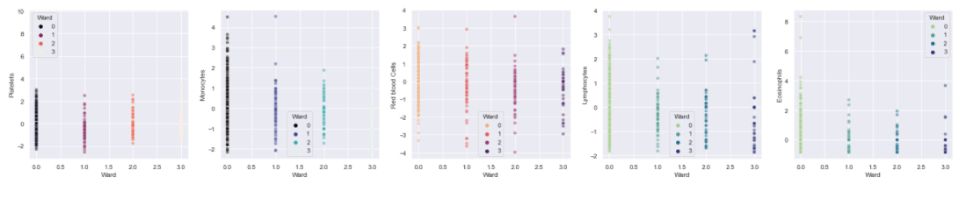
Data Cleaning and Transformation
Observation Stage
- 88% missing values - Not all in binaries
- Unidentified Lab test
Actions Taken
- Drop unwanted columns and >95% missing values
- Convert to binary
- Grouping Lab Results
Outliers Observation
Notes:
May use Random Forest to take in the missing values
Cross Validation Analysis to avoid possible overfit due to small dataset

Slide 12
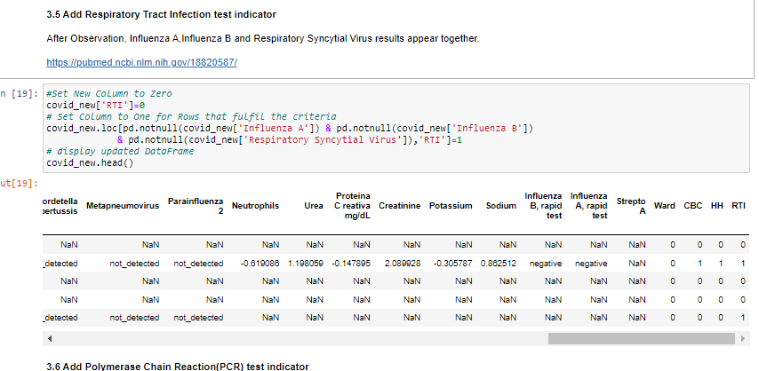
Data Cleaning and Transformation
Notes:
May use Random Forest to take in the missing values
Cross Validation Analysis to avoid possible overfit due to small dataset

Slide 13
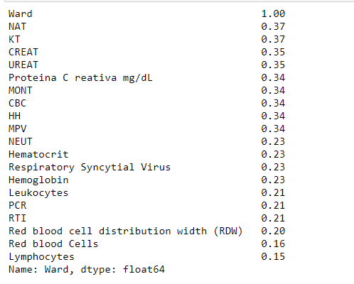
Data Cleaning and Transformation
Observation : The red rectangle box highlights those lab tests are highly correlated with the wards.

Slide 14
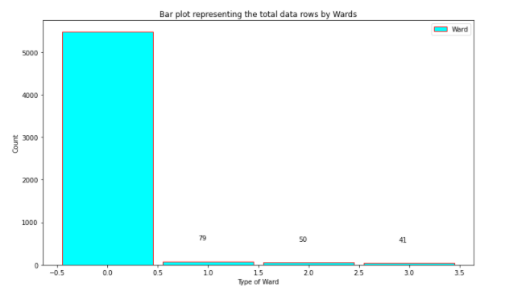
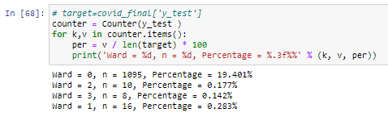
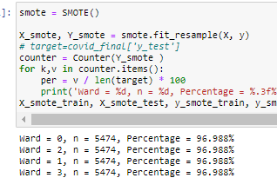
Imbalance Data
Stratify split +Smote Train result
Smote result
Ward = 0, n = 5474, Percentage = 96.988%
Ward = 2, n = 50, Percentage = 0.886%
Ward = 1, n = 79, Percentage = 1.400%
Ward = 3, n = 41, Percentage = 0.726%
Notes:
May use Random Forest to take in the missing values
Cross Validation Analysis to avoid possible overfit due to small dataset

Slide 15
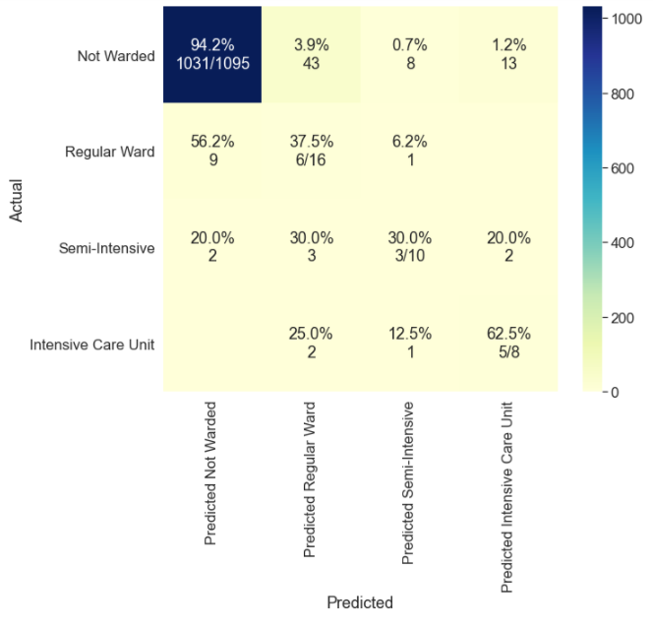
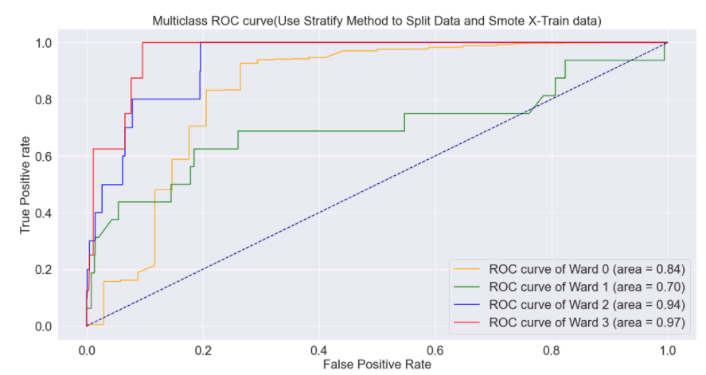
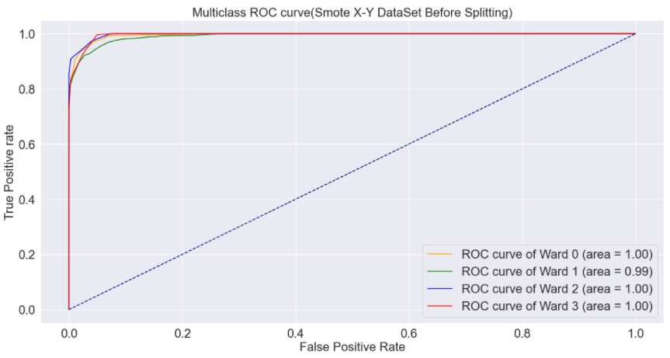
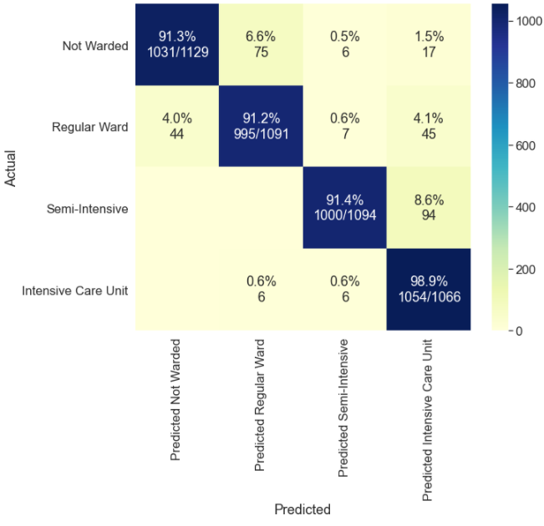
Imbalance Data Con’t
Method Chosen :
Smote whole dataset before splitting to train and test dataset.
Factor 1 : Improves ROC and AUC score.
Factor 2 : The accuracy improved among the wards.

Slide 16
Tell the differences

Slide 17
Model Building
Multi-Class Classification Approach -
Predict 4 classes - No ward = 0 , Regular Ward = 1, Semi-Intensive Unit = 2, Intensive Care Unit = 3
Combine all classes into column
Smote the whole dataset
Split the Smoted dataset into Train and Test data
Use Lazy predict to shortlist 3 models to train
Train selected classifier models
Use the above classifiers to predict for the test data
Measure balanced accuracy with Confusion Matrix ,Classification Report (F1 Score, Recall, Precision),ROC AUC graph
Feature importance

Slide 18
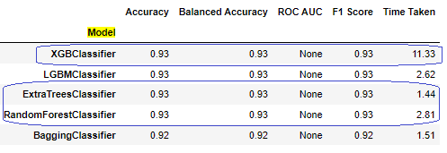
Shortlist Model with Lazy Predict
All the results are similar, except for the time taken to complete each prediction.
Pick 3 models from the top 4 models that have the best balanced accuracy.

Slide 19
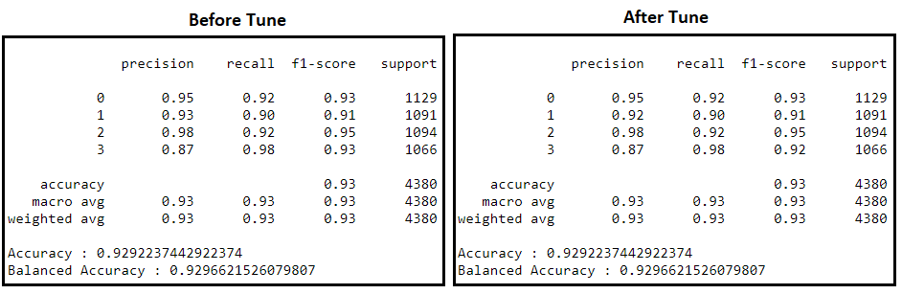
XGBoost Classifier
Original Parameter :{"objective" : ['multi:softprob']}
Grid Search Parameter
{"max_depth" : list(range(1,20)), "n_estimators" : list(range(50,401,25)) ,
"objective" : ['multi:softprob'], "eval_metric" : ['mlogloss']}
Best parameters {"max_depth" : 18, "n_estimators" : 400 }
Observation : No improvement is observed, despite the fact that different parameters are used.

Slide 20
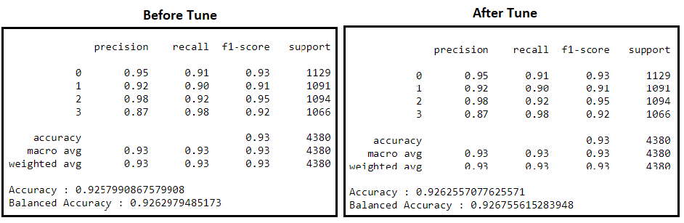
Extra Trees Classifier
Original Parameter :No Parameter define
Grid Search Parameter :
{"criterion" : ['entropy','gini'] , "n_estimators" : list(range(50,401,25)), "min_samples_split" : list(range(1,20))}
Best parameters {'criterion': 'entropy', 'min_samples_split': 2, 'n_estimators': 375}
Observation : There is slight improvement in accuracy and balanced accuracy score.
Improvement:
Accuracy : +0.000457
Balanced Accuracy : +0.000458

Slide 21
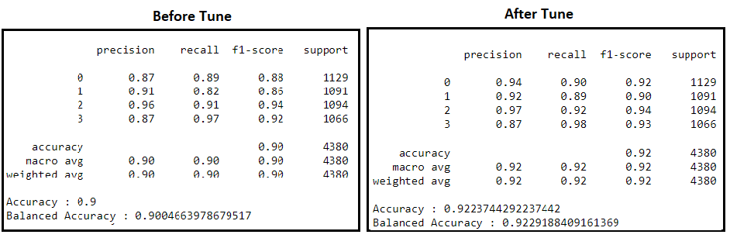
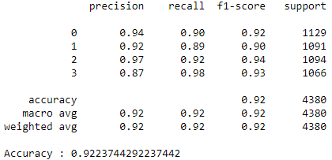
Random Forest Classifier
Original Parameter : {criterion="entropy",max_depth=10,n_estimators=10,max_features="auto"}
Grid Search Parameter :
{"criterion" : ['entropy','gini'] , "max_depth" : list(range(1,15)),
'max_features': ['auto','sqrt','log2'], 'n_estimators' :list(range(1,20))}
Best parameters : {'criterion': 'entropy', 'max_depth': 14, 'max_features': 'auto', 'n_estimators': 15}
Observation : All the scores have shown significant improvement.
Improvement:
Accuracy : +0.022374
Balanced Accuracy : +0.022452

Slide 22
Final Model Selection Summary
Select Model : XGBoost Classifier
Higher balanced accuracy
Higher ROC and AUC score
It has higher true positive and lower false positive prediction.
Drop Model : Extra Trees Classifier and Random Forest Classifier
Lower balanced accuracy
Lower ROC and AUC score than the selected model.

Slide 23
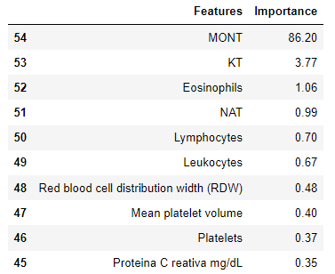
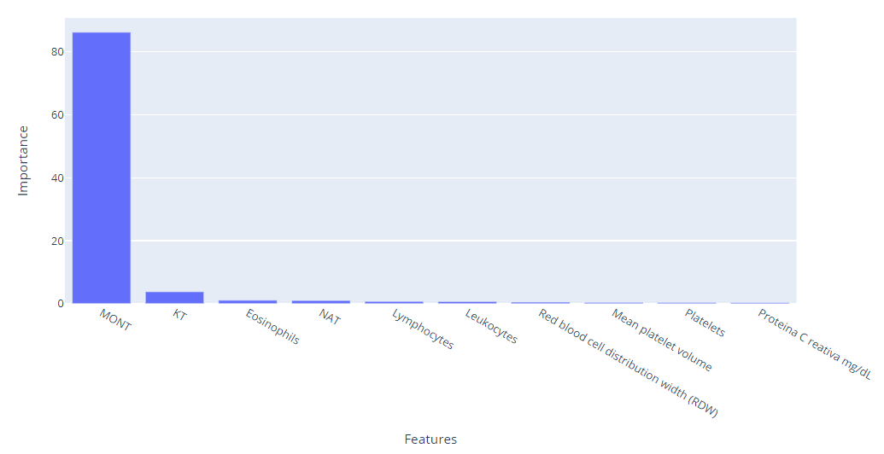
Feature Importance
Monocytes is identified to have the most influence when comes to determine the type of wards for the infected patients.
Monocytes are a type of leukocyte (white blood cell) and they are powerful defenders that are vital in protecting the body against infection.
This shows that our hypertuned model has given us an accurate result, allowing us to learn about this feature and to investigate into it.
https://www.healthline.com/health/absolute-monocytes#function-in-the-body

Slide 24
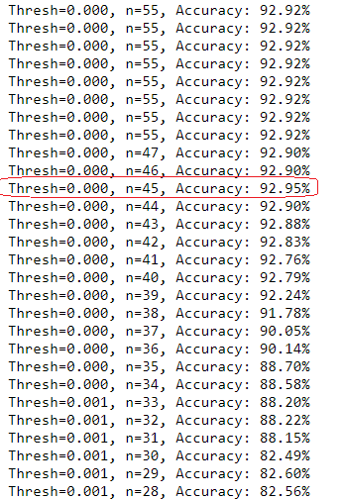
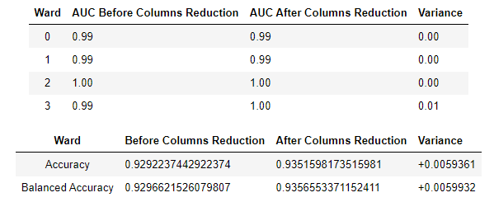
Feature Selection
The performance of the model generally decreases with the number of selected features, except when the number of features reached 45, which actually increase the accuracy by 0.05%.
It is proven that that accuracy improved after reducing the columns to 45 and the auc curve for ward 3 actually improved by 0.01.

Slide 25
Recap and Conclusions
A quick recap
Managing large missing values, smote the entire data to tackle the imbalance data, develop multi-class target and understanding viruses and grouping them.
We saw little to no predictions initially, but after we perform thorough cleaning, it has significantly improves our data quality.
Lazy Predict has been used to identify machine learning models and evaluating the performance metrics.
After hyperturne the chosen models, we use Max Voting to combine multiple machines to make prediction and vote the best.
XGboost is the best model and was hypertuned before conducting Feature Importance. The final result we gotten is 0.93%

Slide 26
If we were to do it again, we will try this approach
After we had treated the data, we would go with a Bayesian Neural Network (BNN), given that it would take all the inputs into consideration and predict the wards.
BNN is said to take a probabilistic approach to deep learning that account for uncertainty due to measurement error, noise in the label or insufficient data availability for the model to learn effectively.
PyMC3 Library to fit BNN and is something to explore and also implement cutting edge inference algorithms.

Slide 27

Thanks!
Any questions?
You can find us at:
https://github.com/lilinchen84
https://github.com/limsweeming
https://github.com/auyuhjiin

